Slide 1
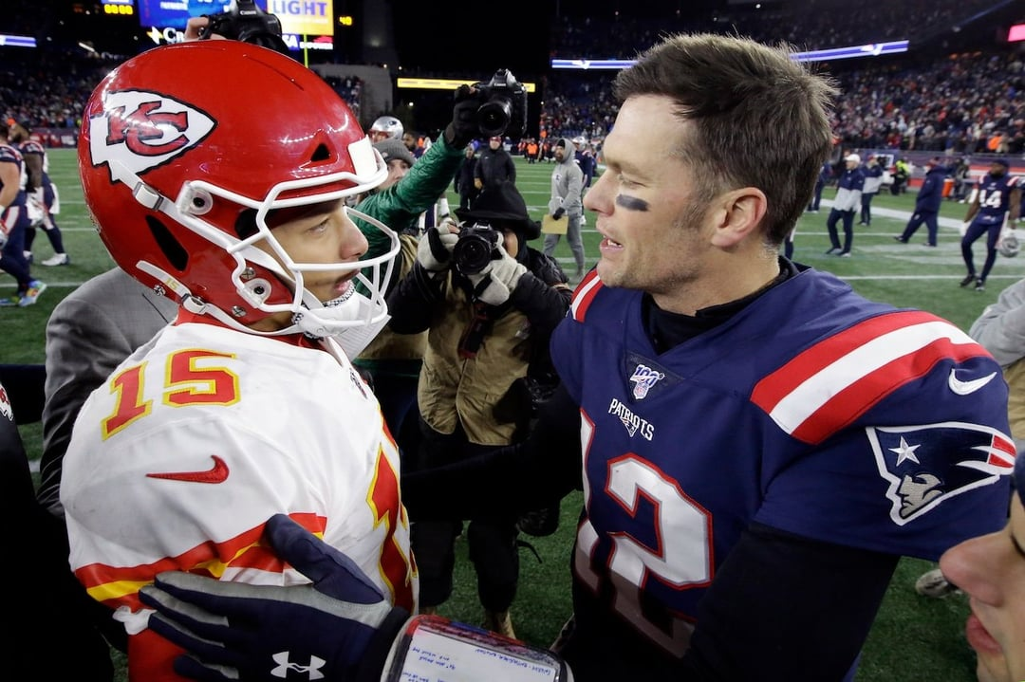
Forecasting the
NFL GOAT QB with
Artificial Intelligence
AI Forecasts How the Tom Brady vs. Patrick Mahomes Debate Will End

